Slide 1
1 Planed
plan 1
Report the test of project1 , project2, project3.
4

Slide 2
1 Results
Results 1
Then I will show you.
4

Slide 3
1 Project1
1.1 Requirements
This project requires you to parse two applications with different architectures for their DOS headers, NT headers (including signature, coff header and optional header), and section headers and print out their values in a format like (field name: field value).
4

Slide 4
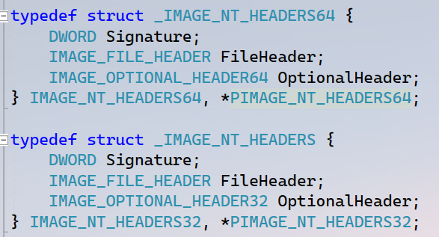
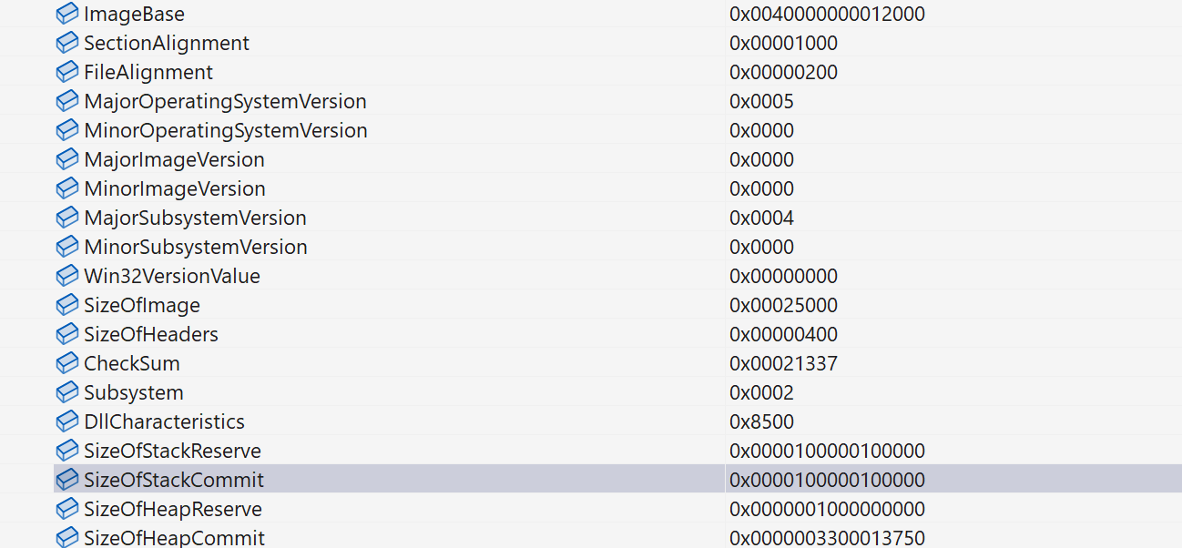
1 Project1
1.2 challenges and solutions
Before developing a program to parse the Headers, It is important to note the difference of the NT header between x64 and x86.
The differences of it is that some members of optional header are different in x64 and x86. Please look at the screenshot. We can notice the OptionalHeader is different.
If we parse the 32-bits exe by the structure `IMAGE_NT_HEADERS64` we will catch in a awkward situation.
Solution: So we need to develop two functions to parse 32-bits exe and 64-bits exe respectively.
4

Slide 5
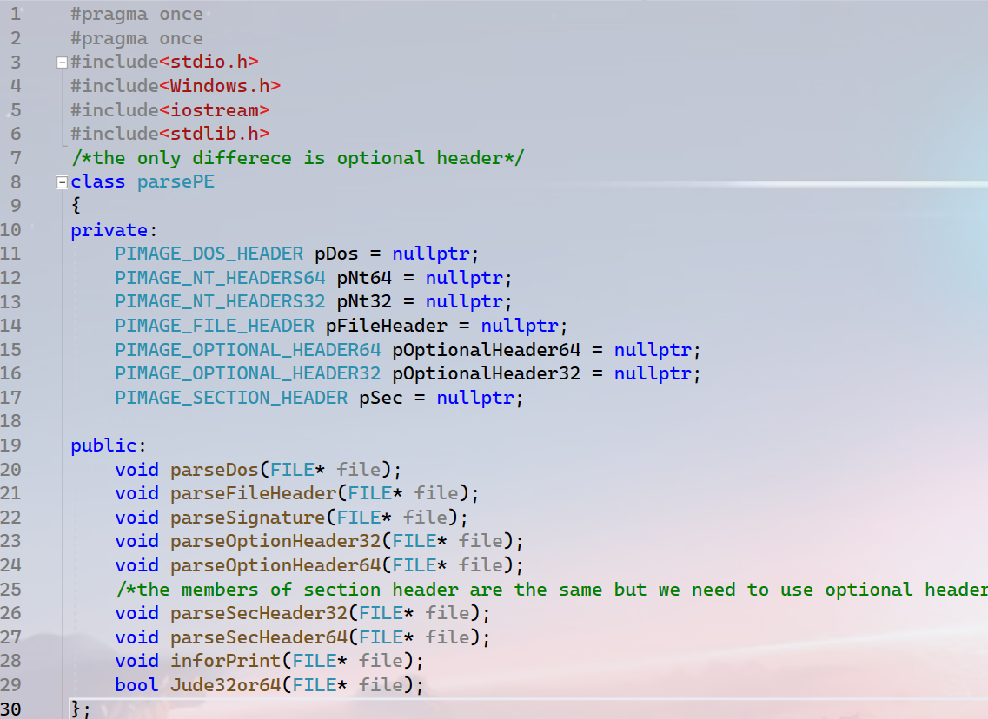
1 Project1
1.3 Main Parts of Code
The code link:csci-591-fall2023-private/project1 at main · QXinHan/csci-591-fall2023-private (github.com)
I define a class named ‘parsePE’ in ‘function.h’ to implement the function I want.
Please notice that the section header is the same in x64 and x86, but we need to use the format `pointer + offset` to find the structure of the section header. The `offset` is different because of the difference of optional header.
4

Slide 6
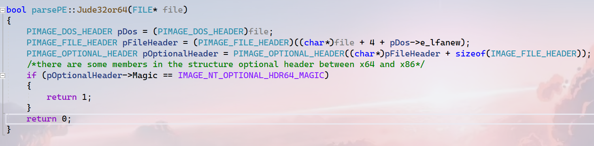
1 Project1
I think the most important function is the `Jude32or64(FILE* file)`, it is used to judge whether the executable is 32-bits or 64-bits.
Notice: the member `Magic` is the same as in 32-bits executable.(The first member of the structure and the size is the same.)
1.3 Main Parts of Code
4

Slide 7
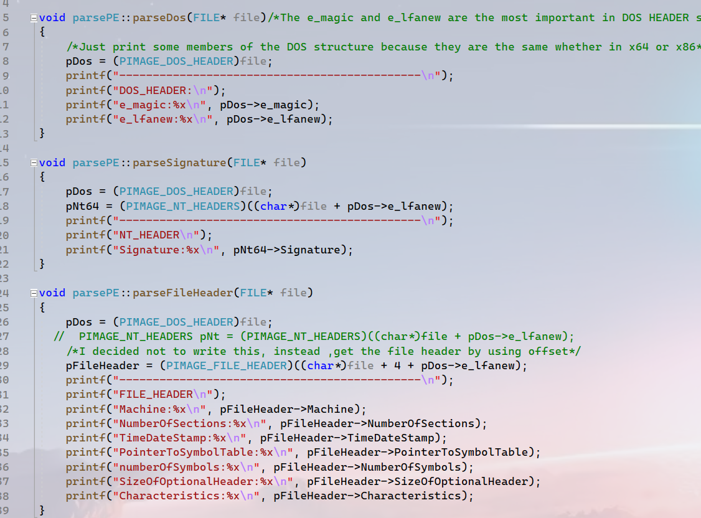
1 Project1
Knowing that there is nothing different between 32-bits executable and 64-bits executable in the structure DOS header, FILE header, and the member `Signature` in NT header so I print the value of them without judging it is 32-bits or 64-bits.
1.3 Main Parts of Code
4

Slide 8
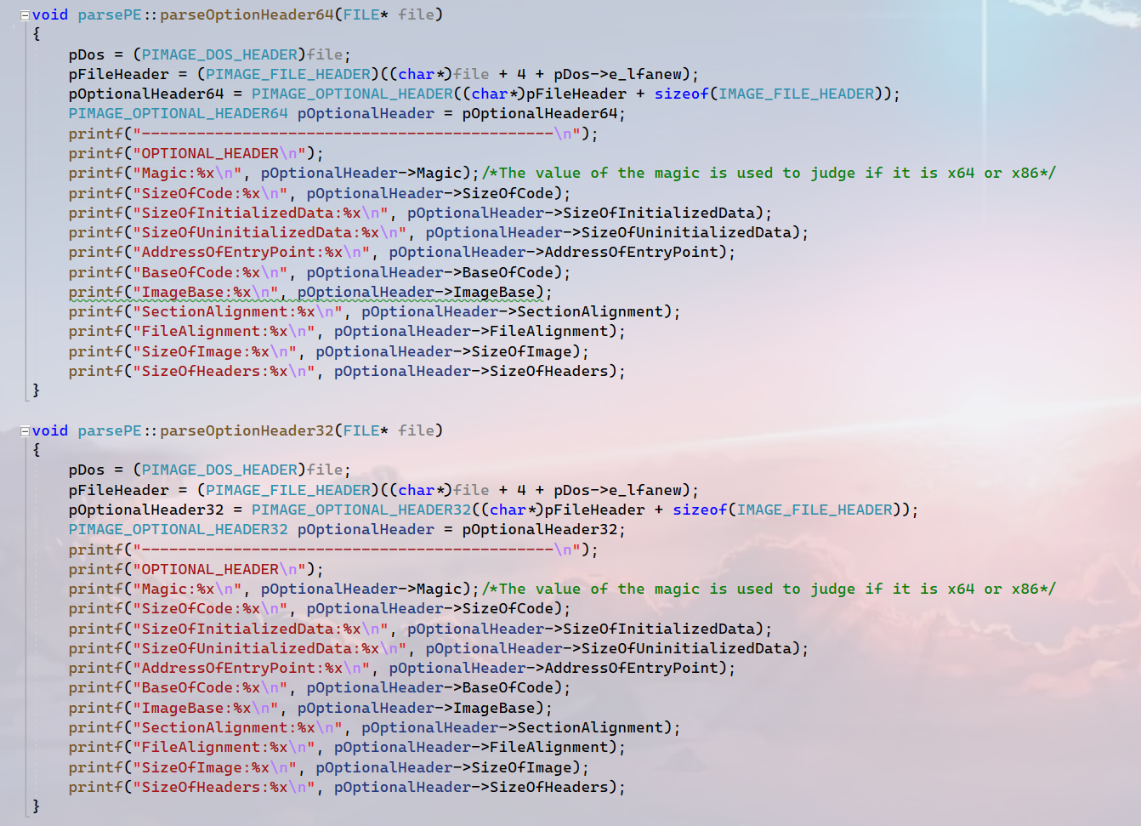
1 Project1
We can easily find that the code are highly similar.
I want to merge the two parts of code into one and the function is the same, but failed.
1.3 Main Parts of Code
4

Slide 9
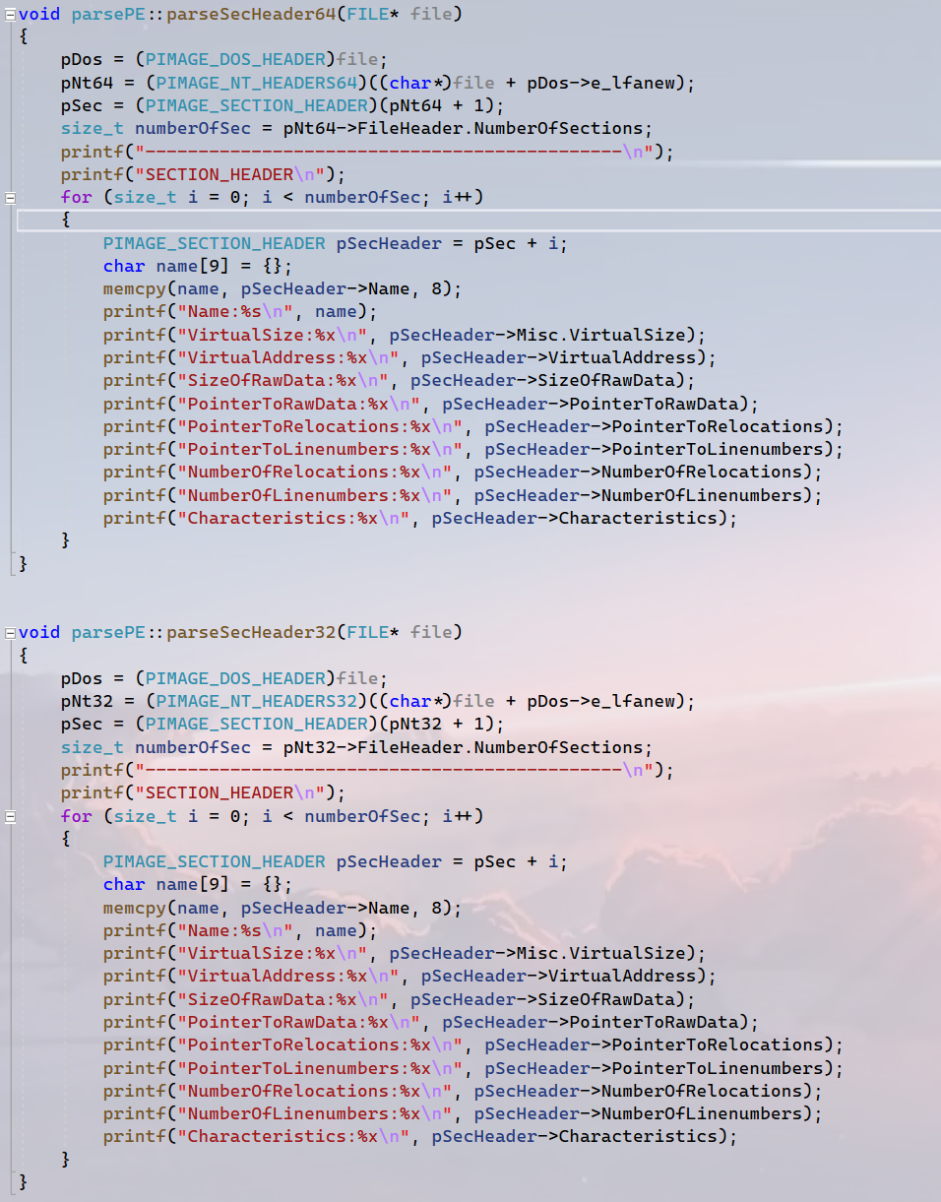
1 Project1
Certainly, the only different is calculation of the `offset` to get the structure of section header.
The code ‘pNt64 + 1’ means ‘(char*)pNt64 + sizeof(IMAGE_NT_HEADERS64)’
1.3 Main Parts of Code
4

Slide 10
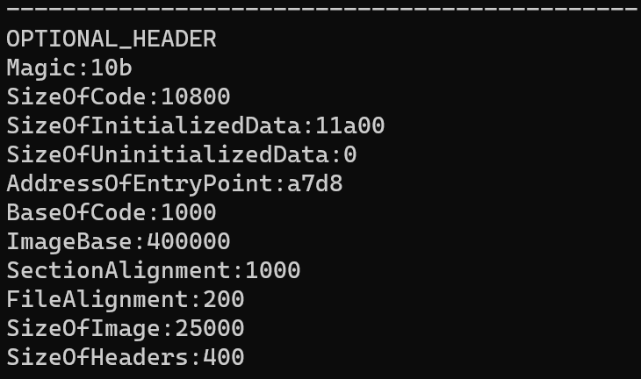
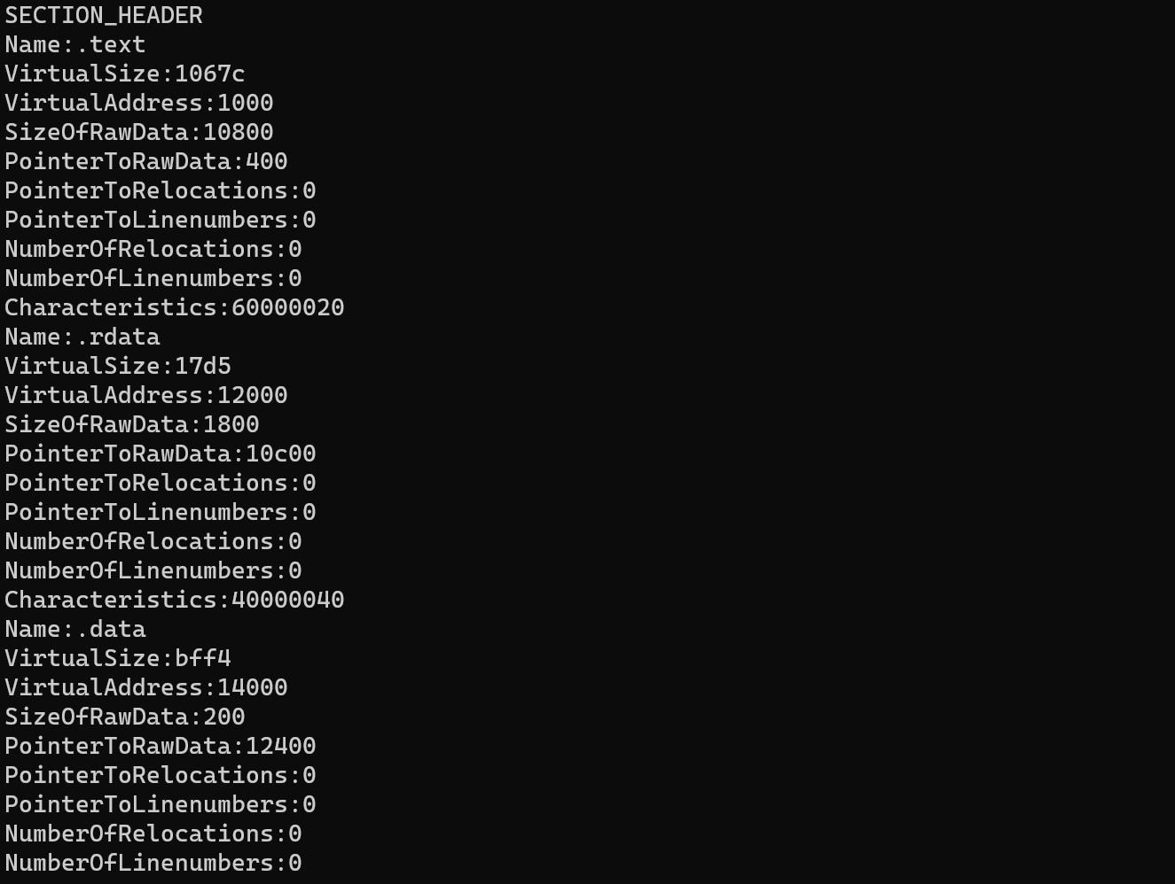
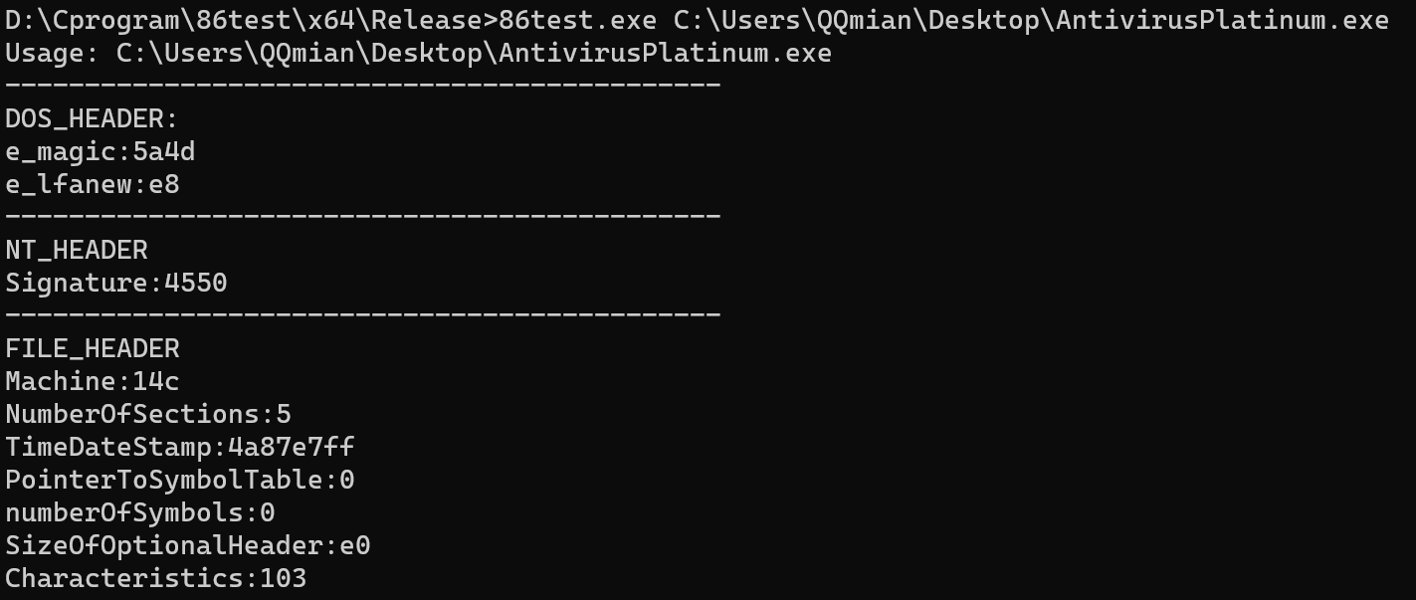
1 Project1
1.4 Result
The 32-bits executable
4

Slide 11
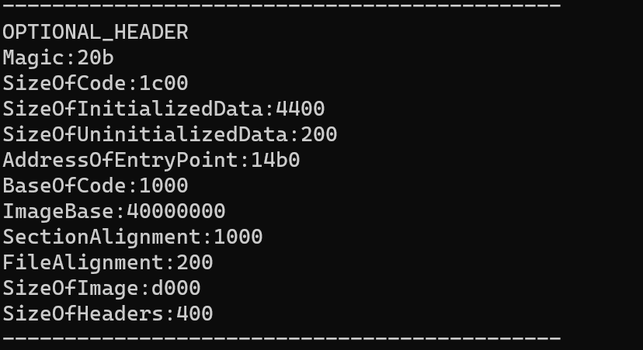
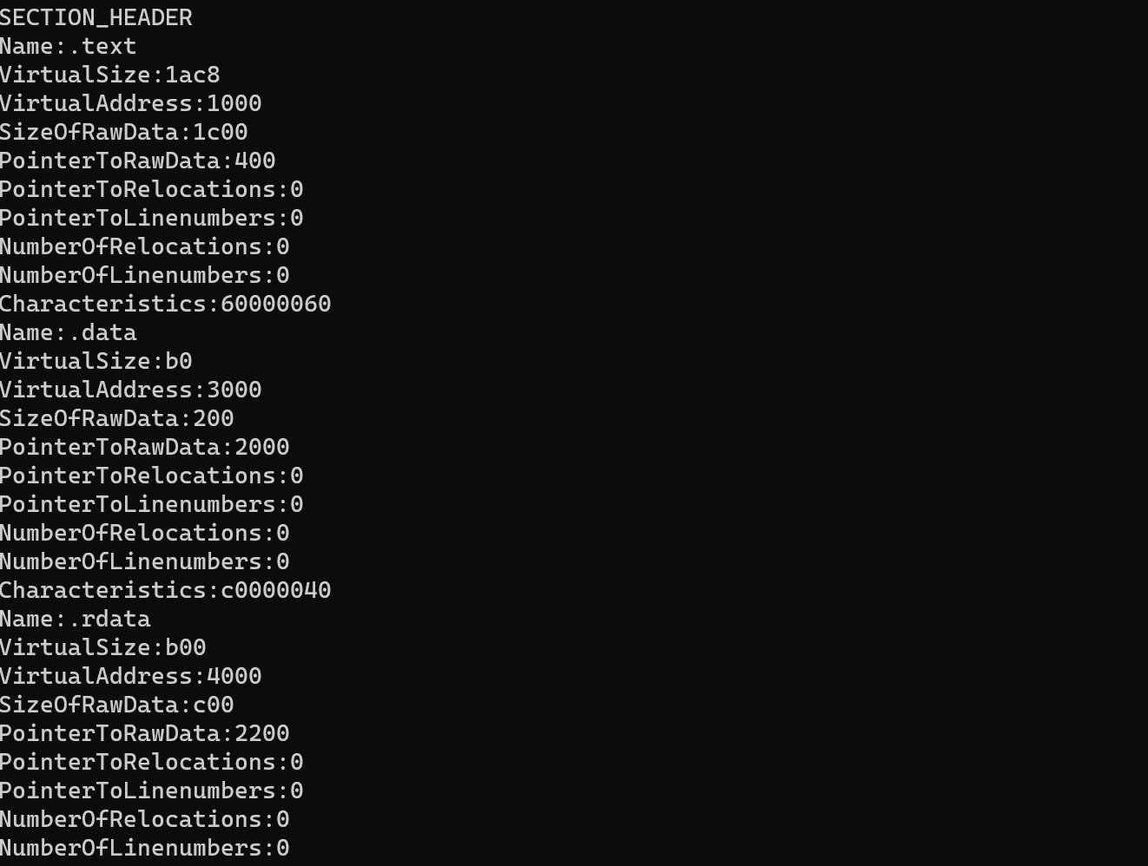
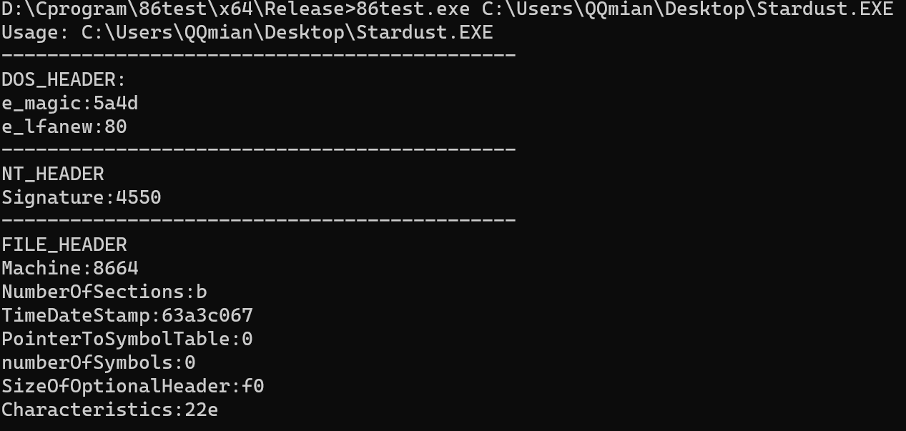
1 Project1
1.4 Result
The 64-bits executable
4

Slide 12
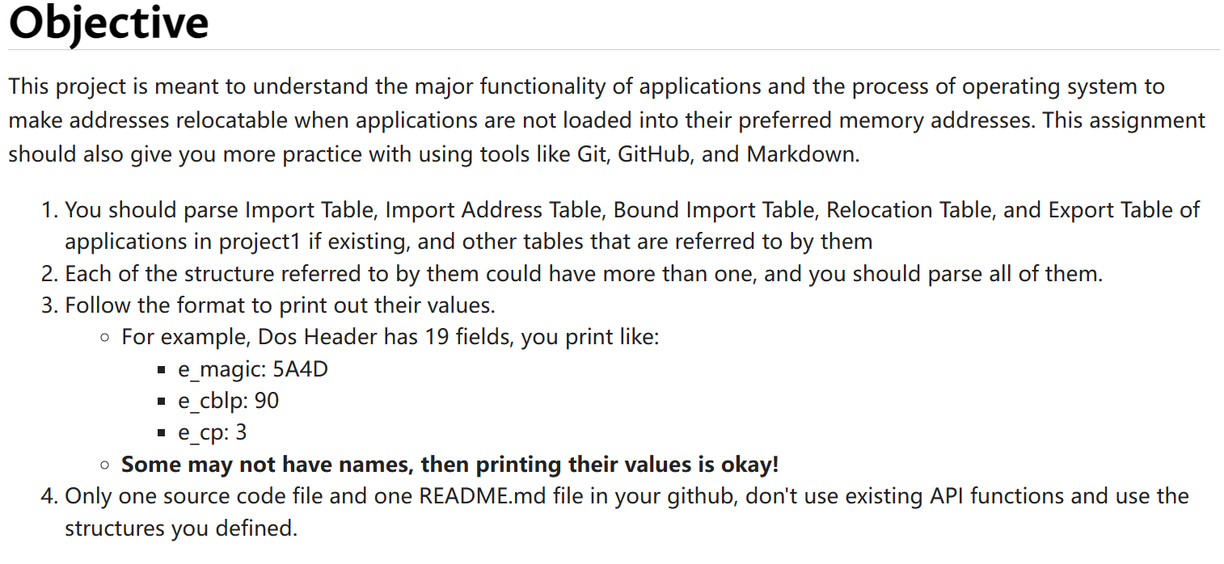
2 Project2
1.1 Requirement
4

Slide 13
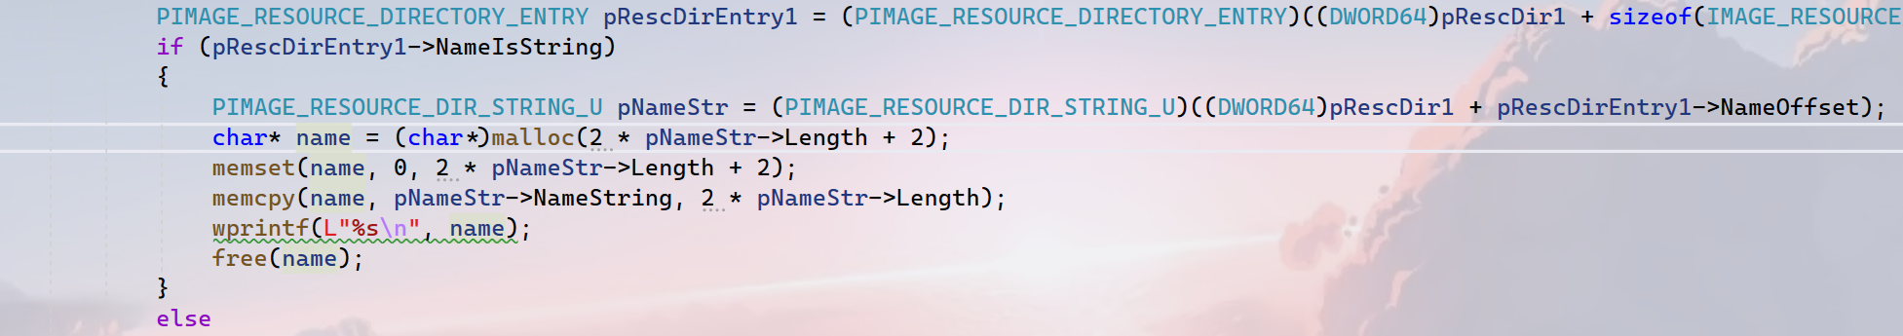
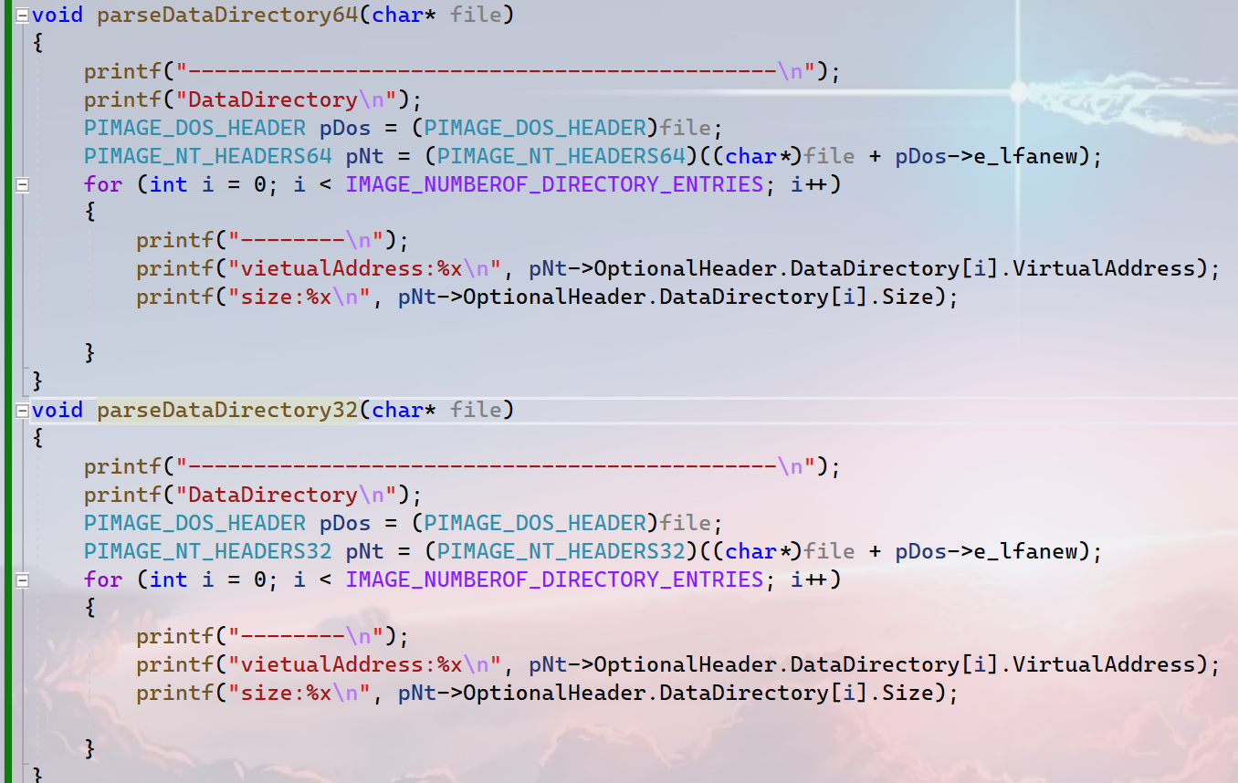
2 Project2
1.2 Challenges and Solutions
1. Please look at the screenshot on the right, while parsing the resource directory, I found that the name of it is not terminated by ‘\0’.
2. the data directory is stored in optional header, so it is different in 32-bits executable and 64-bits executable.
4

Slide 14
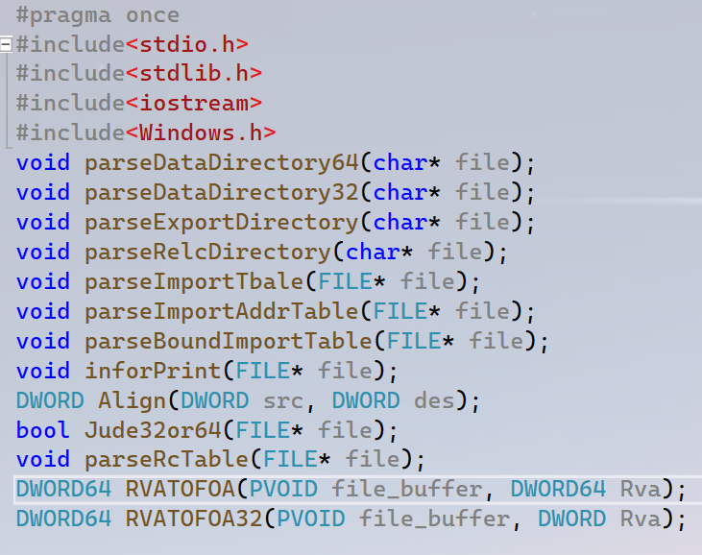
2 Project2
1.3 The Code
The code link:csci-591-fall2023-private/project2 at main · QXinHan/csci-591-fall2023-private (github.com)
I define the functions in the head `function.h` please notice the function `RVATOFOA` and `RVATOFOA32`, We must pay attention to every different details between 32-bits executable and 64-bits executable. Of course the main difference is the optional header I think.
Then I will explain every function not in order in this screenshot. And some of them have already been mentioned in project1, I will not note them.
4

Slide 15
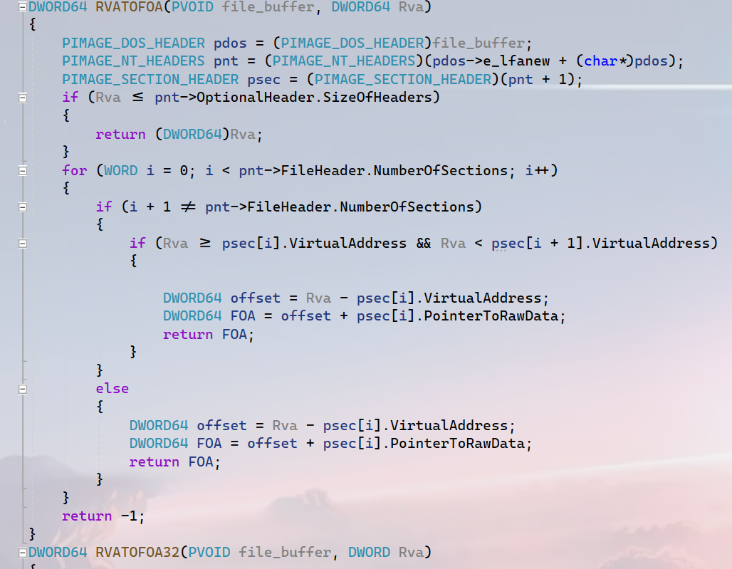
2 Project2
1.3 The Code
Notice that I define two functions `RVATOFOA32` and `RVATOFOA` , the only different part is the structure of `IMAGE_NT_HEADERS64` and `IMAGE_NT_HEADERS32`. So just pay attention to one of them is ok.
Please look at the next slide, I need to explain this part by a figure.
4

Slide 16
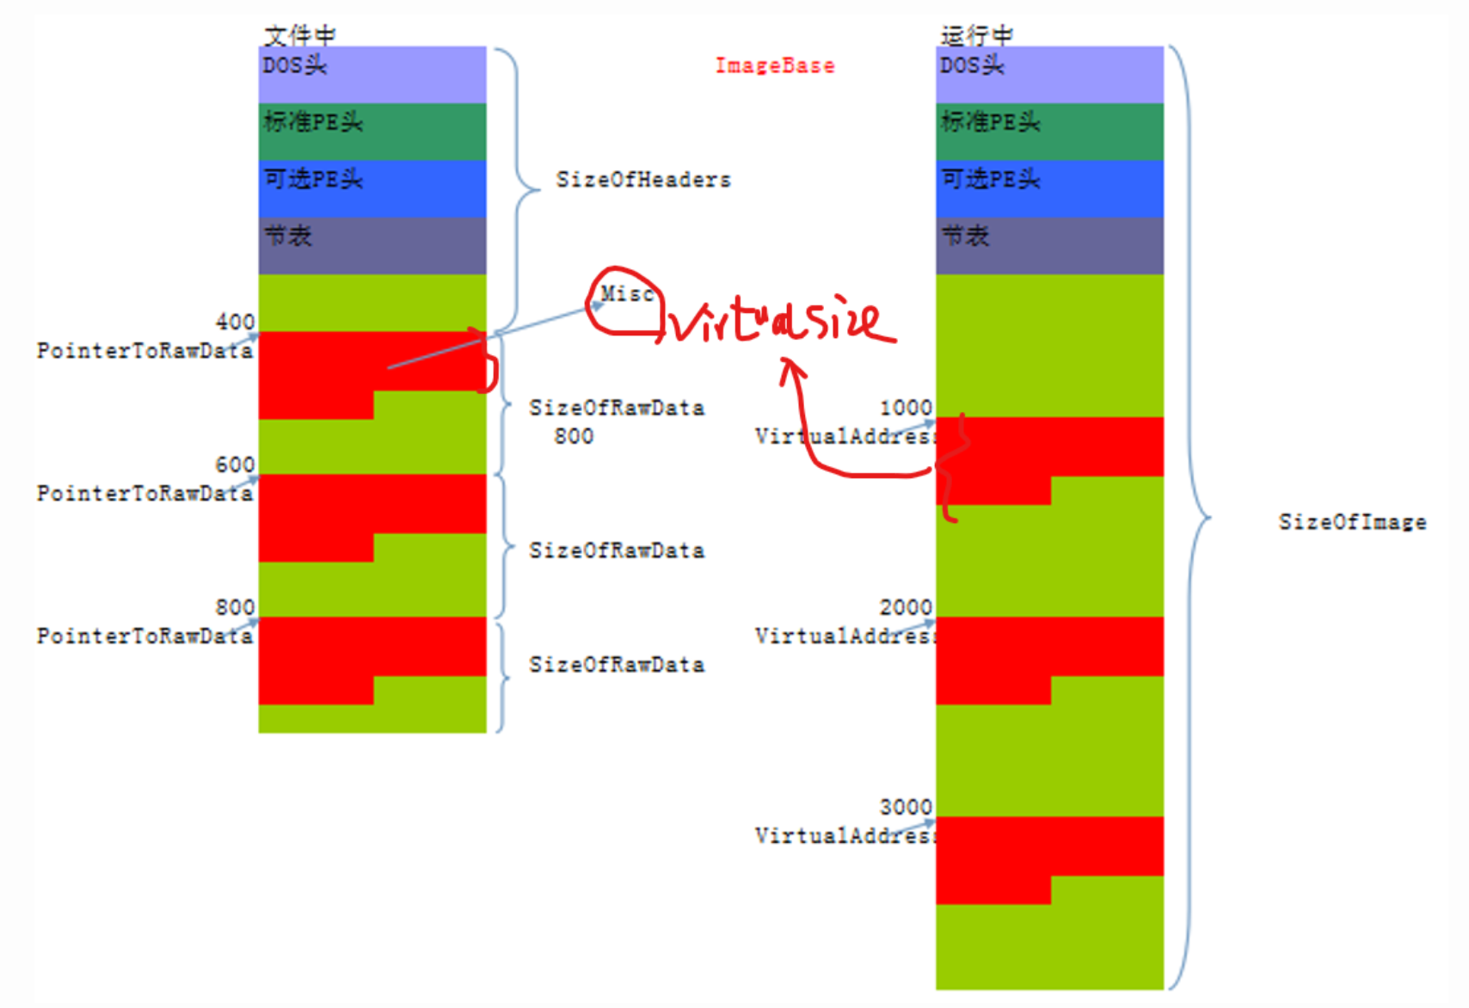
2 Project2
1.3 The Code
The headers will not be stretched.
Pay attention to every section, locate the Rva in which block, and calculate the offset in each block, after plus the offset of the block then we get the foa.
4

Slide 17
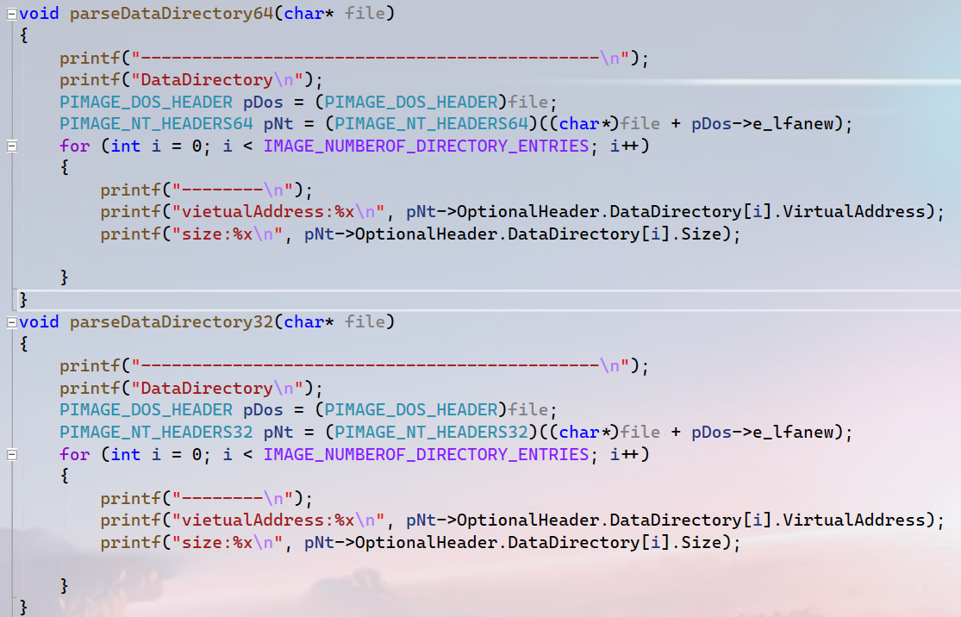
2 Project2
1.3 The Code
The information of data directory is stored in optional header so it is necessary to notice the 32-bits and 64-bits.
4

Slide 18
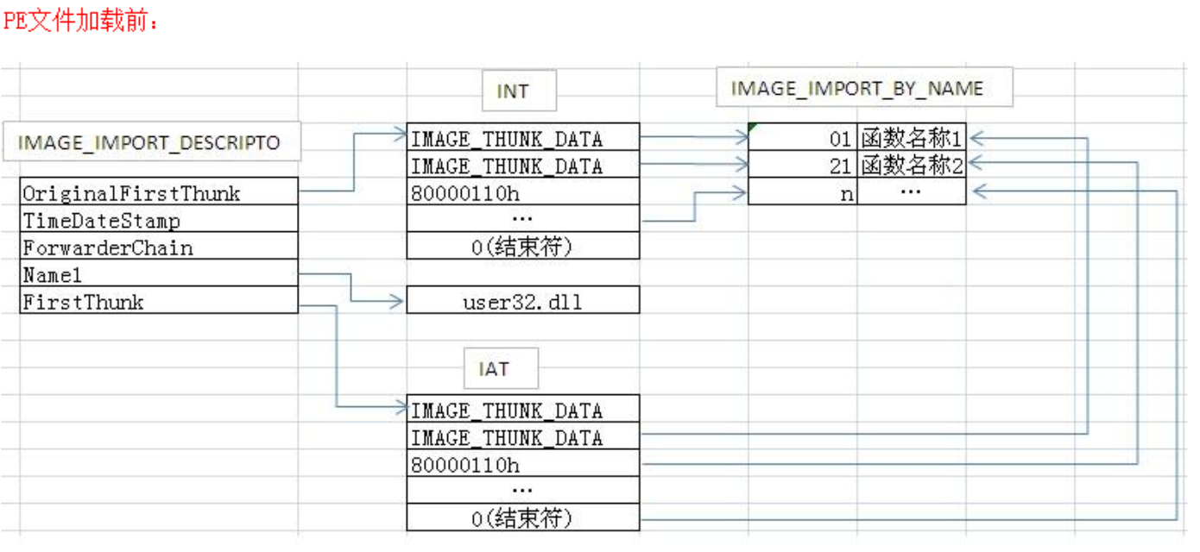
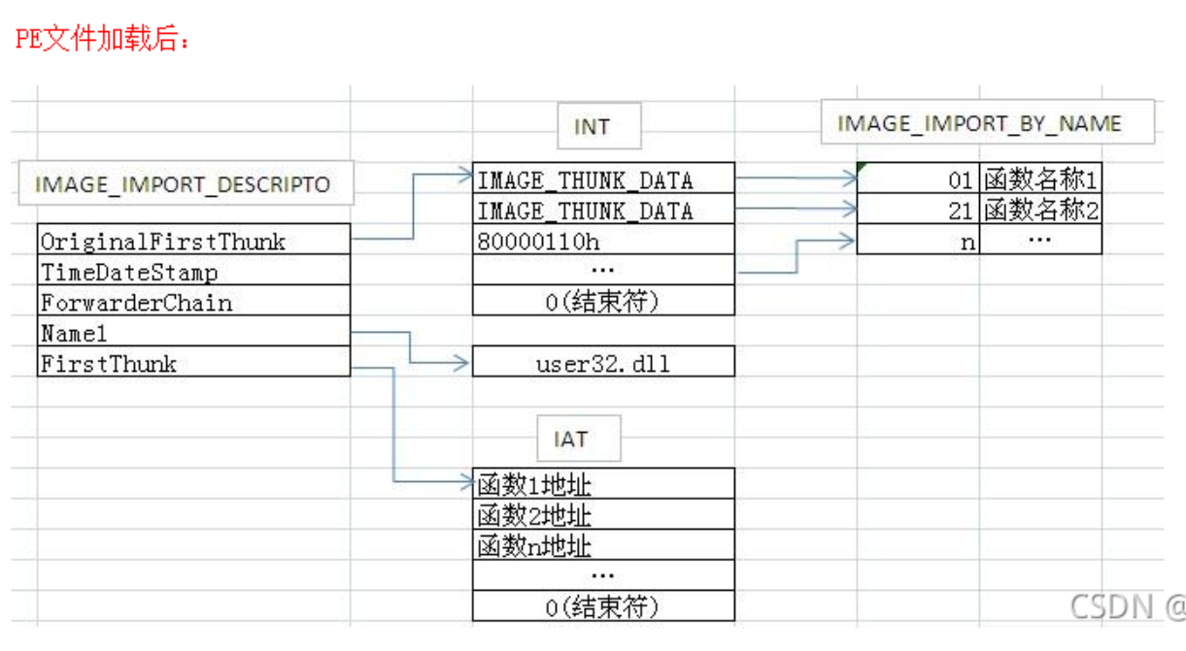
2 Project2
1.3 The Code
This is the structure that we will parse. The PE file that we will parse is on the disk and has not been loaded into memory. So the INT and the IAT is the same.
4

Slide 19
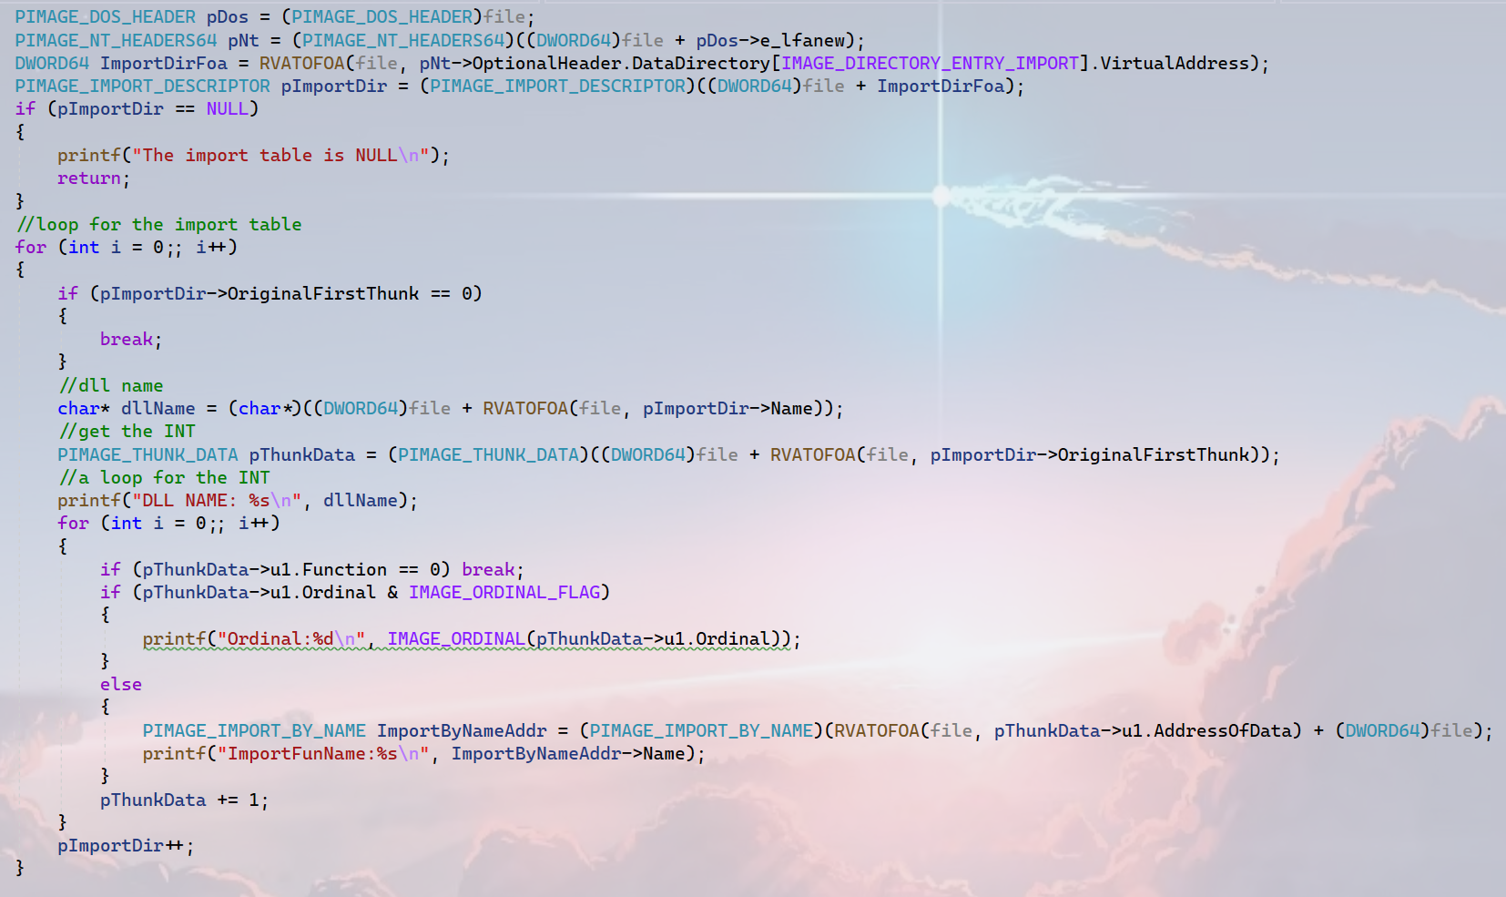
2 Project2
1.3 The Code
There is little different between parsing IAT and import table. Each dll used by a exe, will have a structure in the exe to store the information about it. Each dll has a structure `IMAGE_DATA_DESCRIPTO` and each the structure is bound to a IAT.
Found each IAT and print every function that used by the exe we are parsing.
There is no much difference between 32-bits and 64-bits.
4

Slide 20
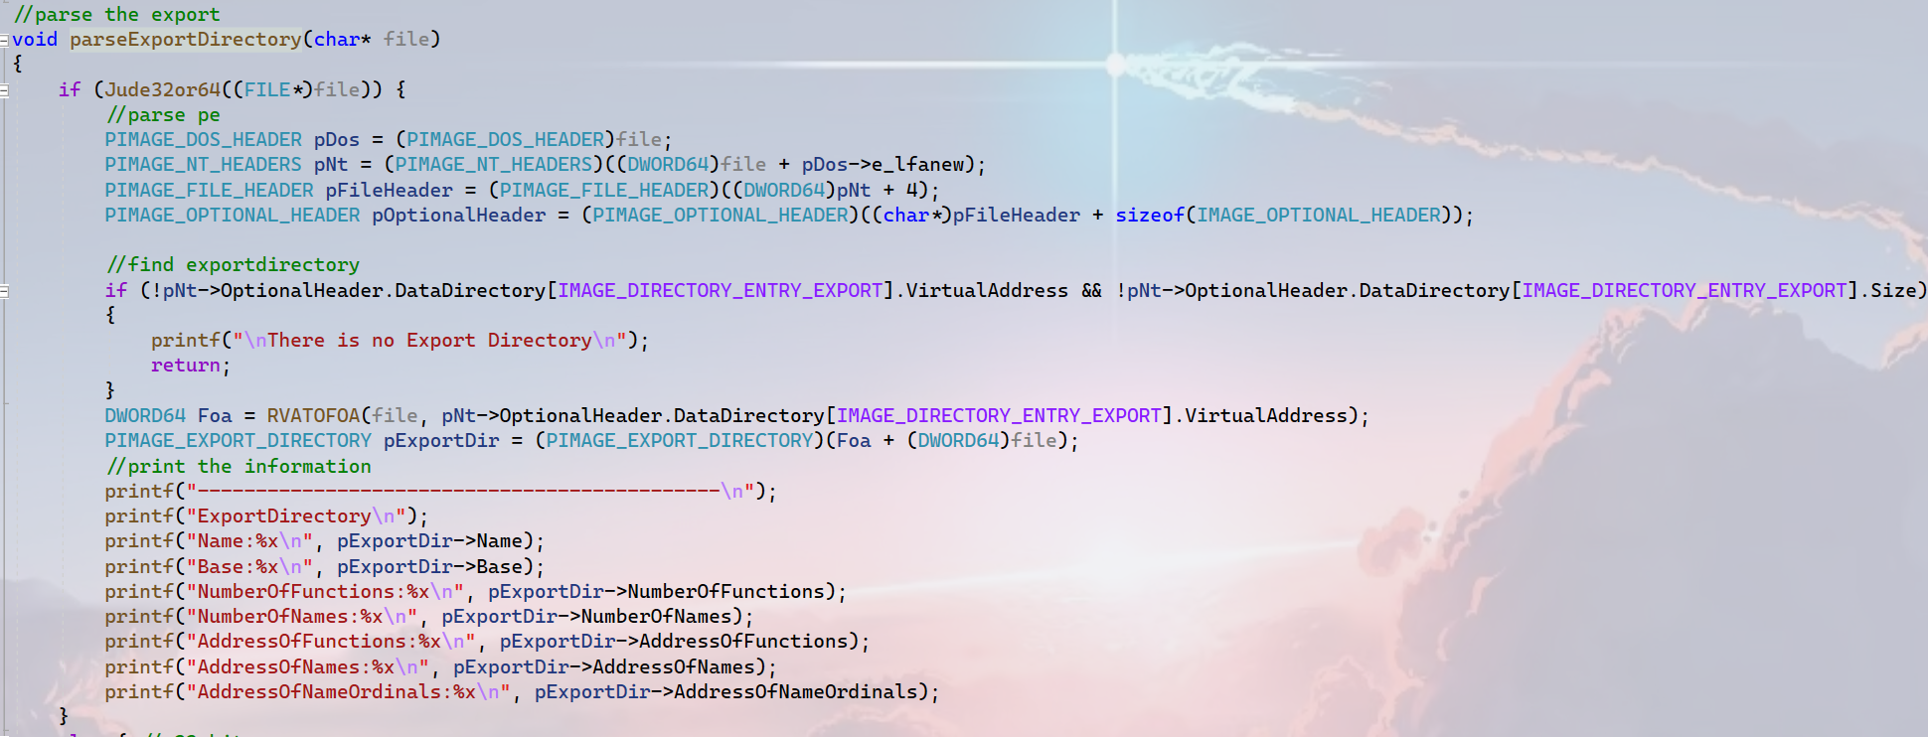
2 Project2
1.3 The Code
In general, most executable does not have export table, but most dlls has. Because they need provide functions to other file.
4

Slide 21
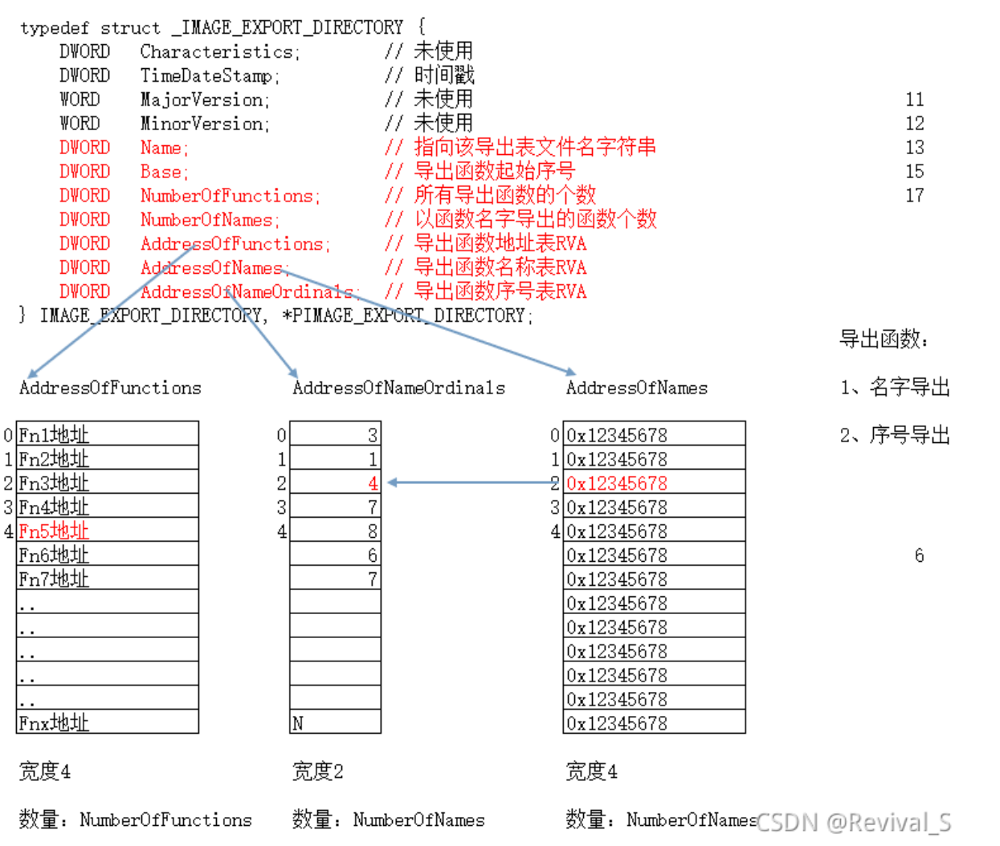
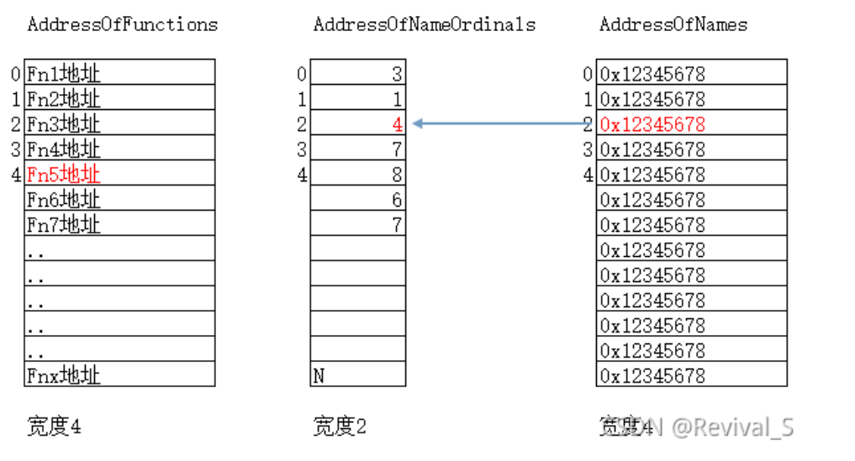
2 Project2
1.3 The Code
The figures to show the structure of export table, and how to get export functions.
Screenshot from : 【精选】滴水逆向三期实践11：导出表-CSDN博客
4

Slide 22
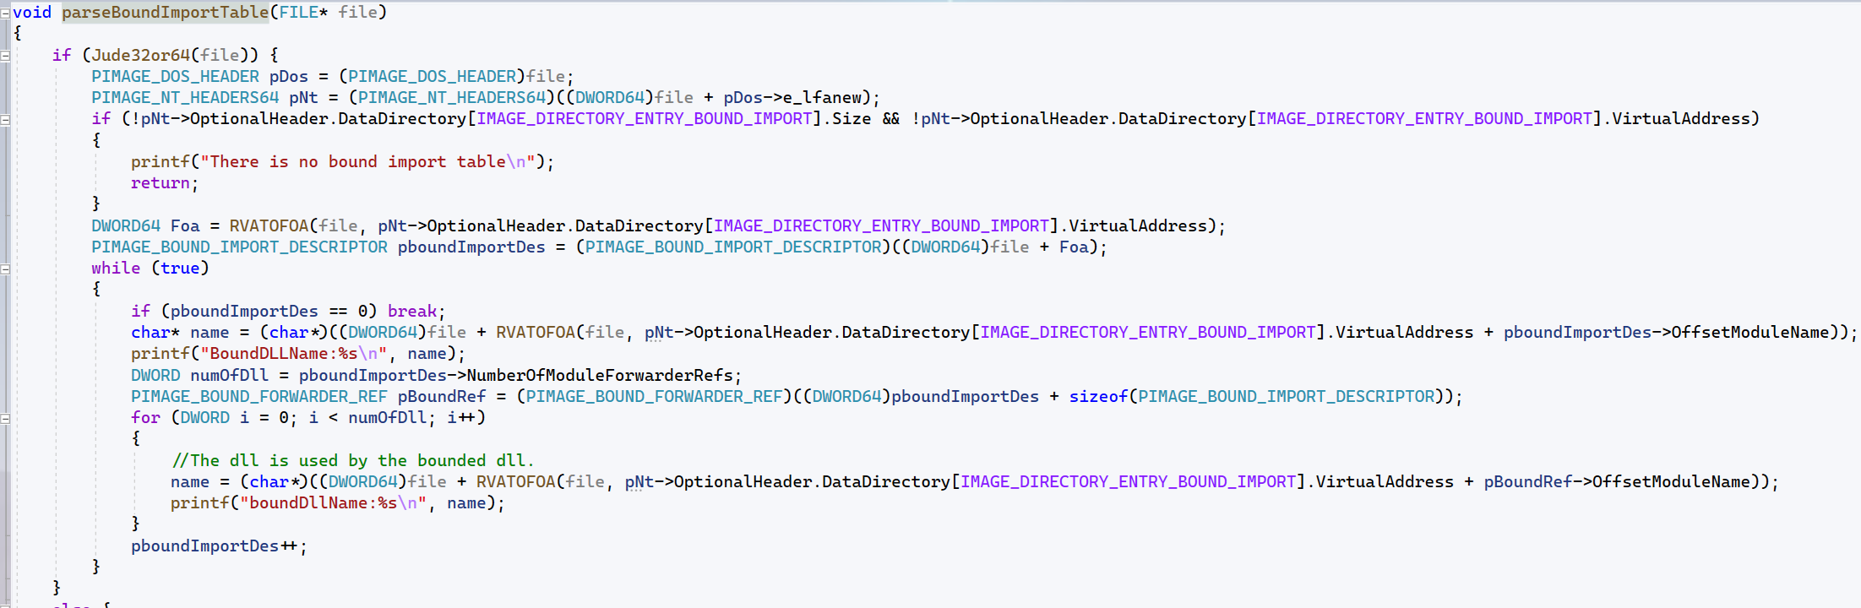
2 Project2
1.3 The Code
The way to parse is similar with relocation table. The next slide is a figure of it.
There is nothing difficult to parse the bound import table.
4

Slide 23
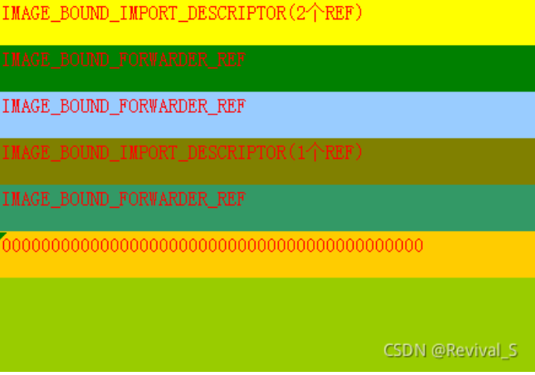
2 Project2
1.3 The Code
Bound import table.
4

Slide 24
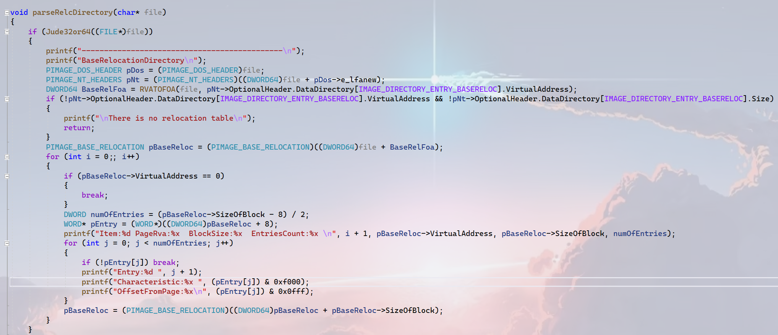
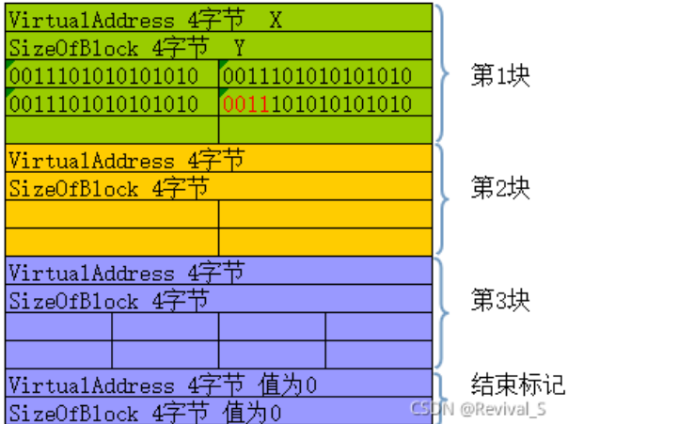
2 Project2
1.3 The Code
Parsing the relocation table is important and the project3 will need it.(repair the relocation table)
It is easy to parse it after knowing the structure of the relocation table.
But notice: the high four bits is not always 0x3(if the address need to be repaired) but may be 0xa.Whatever it is, we can do `pEntry&0x2000` to judge if it will be repaired.(0x3 = 0011 and 0xa = 1010).
4

Slide 25
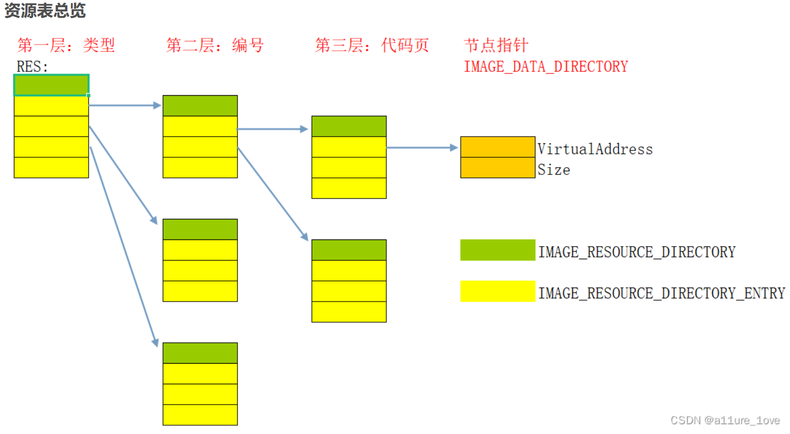
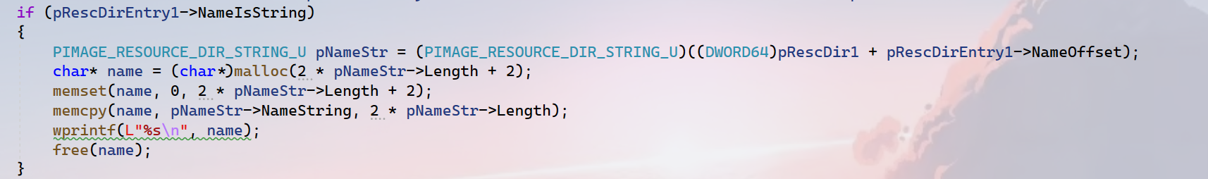
2 Project2
1.3 The Code
It is the most complex part I think. It is a tree structure while parsing it ,and there are two points to be noted.
1.If we need to find the name of a resource , the real address is the address of the first layer of resource table plus the nameoffset.
2.it just provide a pointer to the start of the name, and the length of name. We need to know the name string is `w_char` and not terminated by zero.
Next slide is the code.

Slide 26
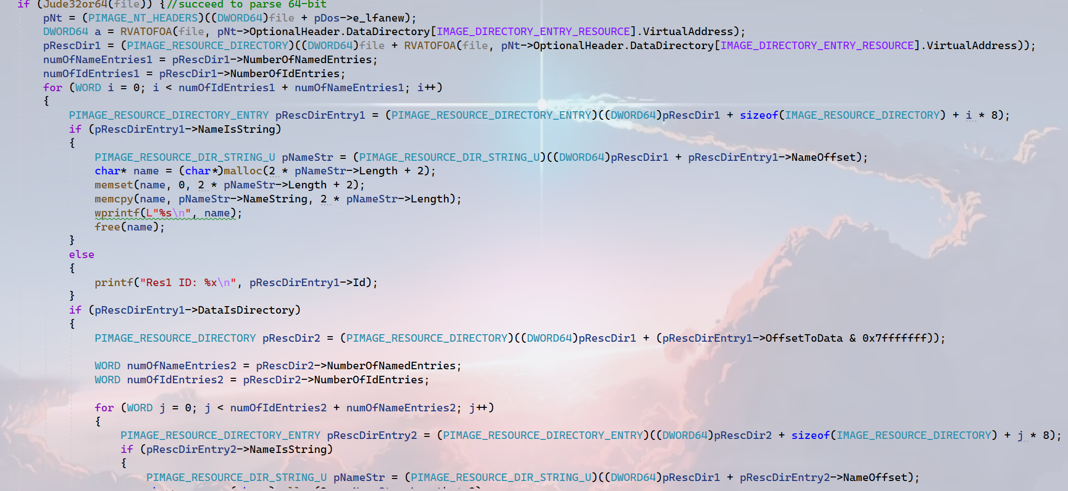
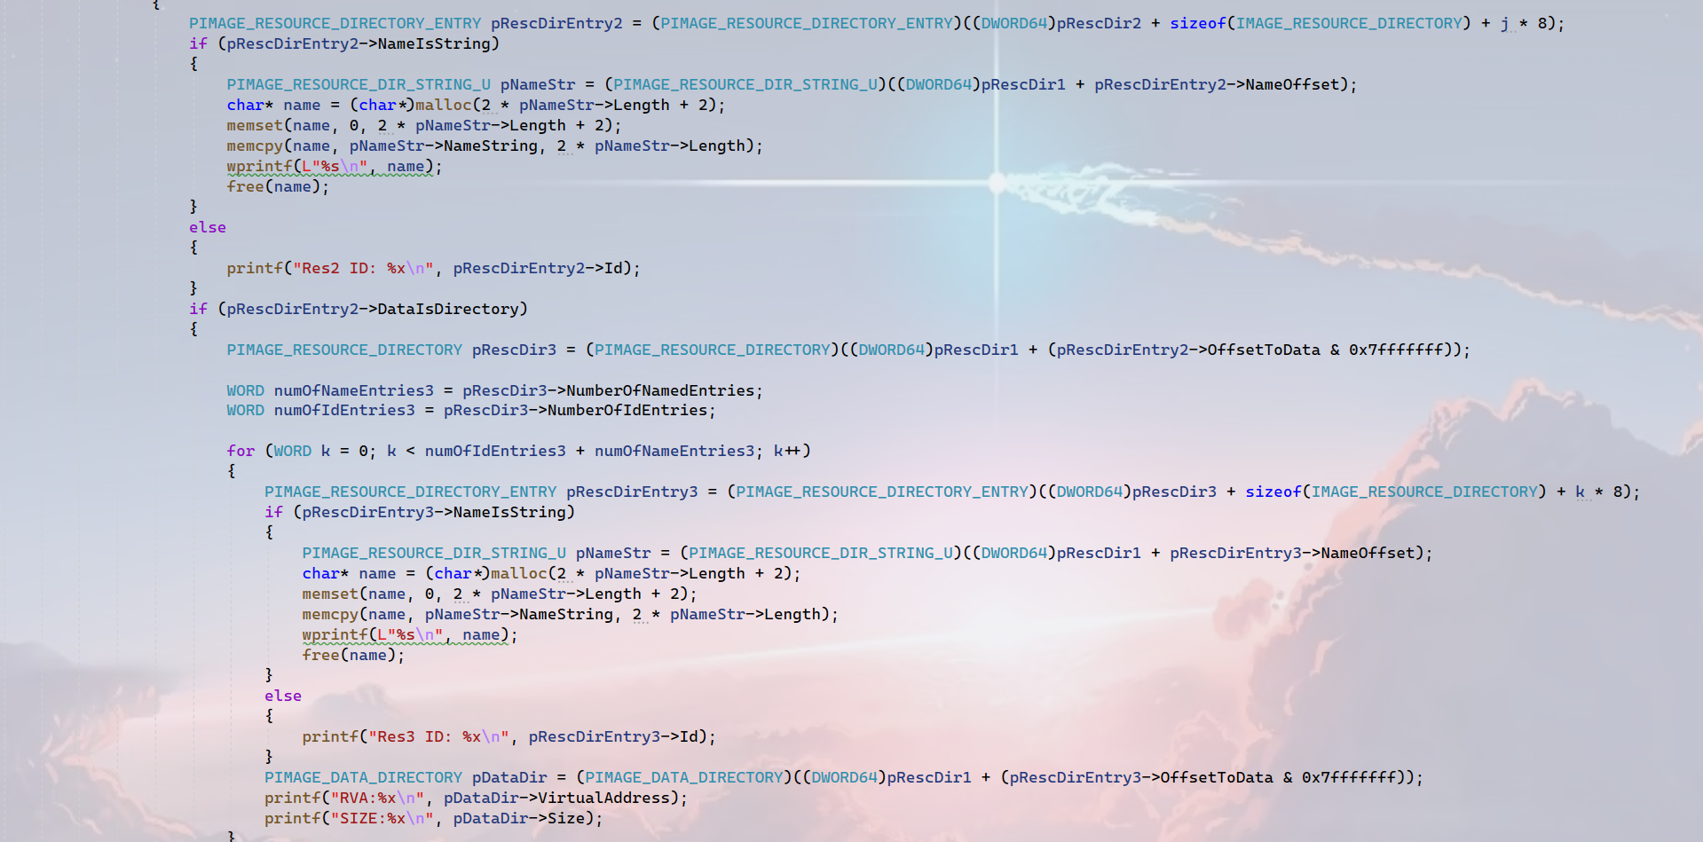
2 Project2
1.3 The Code

Slide 27
3 Project3
1.1 Requirement
If you want get the details of the project requirement please go to the link:CSCI 591 Malicious Code Analysis (fangtian-zhong.github.io)

Slide 28
3 Project3
1.2 Challenge and Solution
The only thing I am confused is the structure `CONTEXT`. The members like ‘EIP,ESP’ of it mean what?

Slide 29
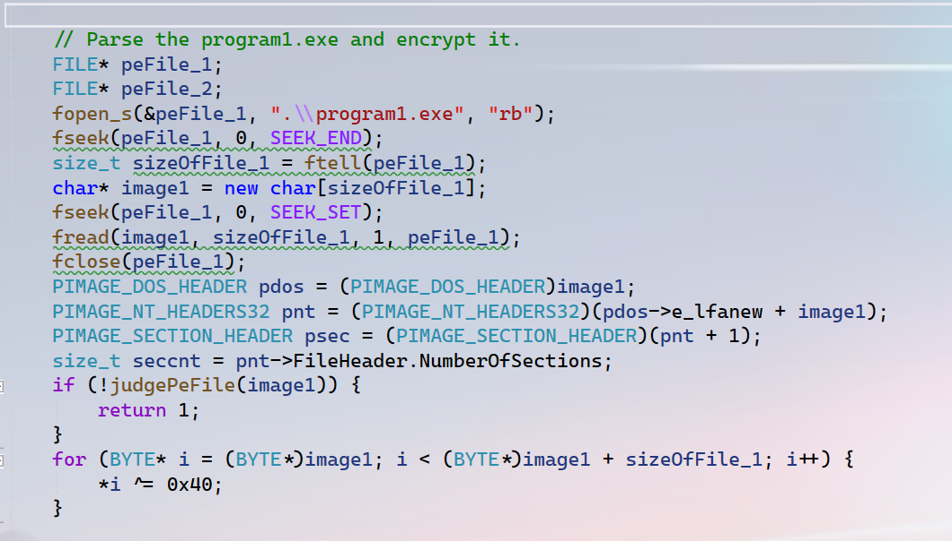
3 Project3
1.3 Code of program3.exe
This part of code is used to parse the program1.exe and encrypt it.(you know program1.exe just prins ‘hello program1’)
Of course the way to encrypt the program1.exe is easy, each byte XOR 0x40. While decrypting, each byte XOR 0x40 is OK.

Slide 30
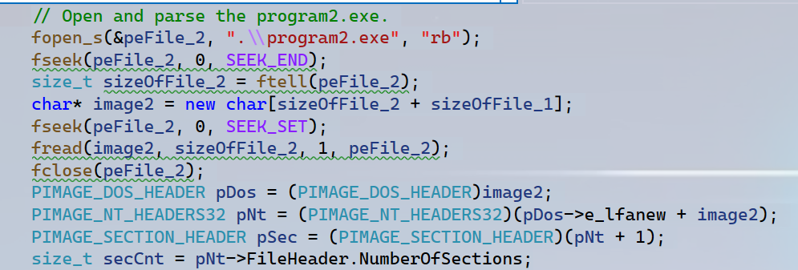
3 Project3
1.3 Code of program3.exe
The way to parse program2.exe is the same as program1.exe.
Notice: By default the program1.exe and program2.exe is in the same directory.

Slide 31
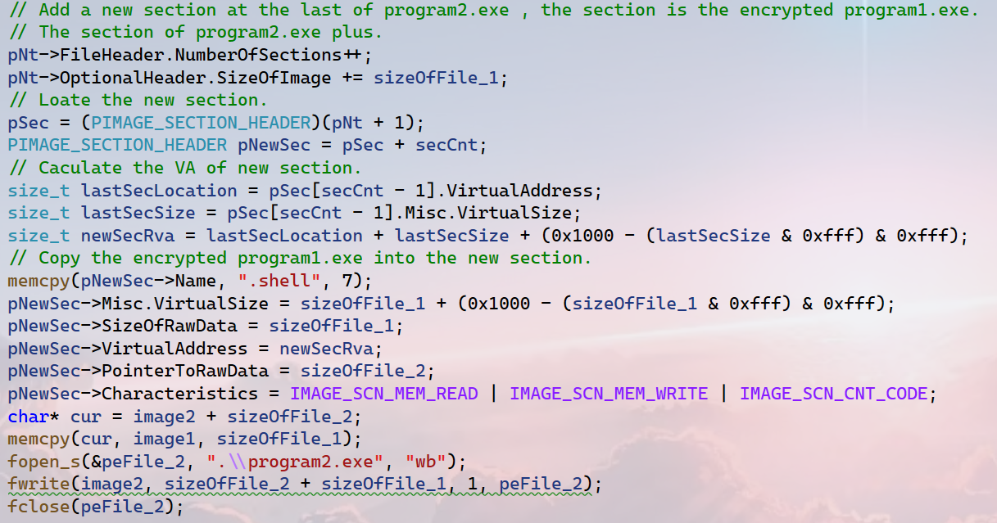


3 Project3
1.3 Code of program3.exe
Add a new section in program2.exe.
Please pay attention to the area of red circle, if the section alignment is not 0x1000 we can not calculate as this.
‘IMAGE_SCN_CNT_CODE’ in this code is useless, because the new section we will stretch it to memory and execute it.

Slide 32
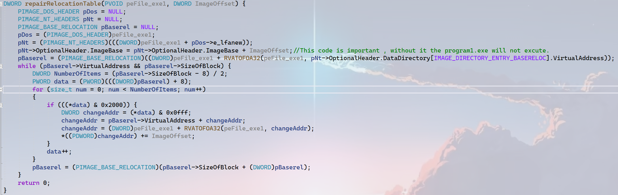
3 Project3
1.3 Code of program2.exe
The code of program2.exe is the most difficult part in project3.
I have mentioned the function `RVATOFOA32` and how to parse the relocation table so it is easy to know how to repair the relocation table “addr + newimagebase - oldimagebase”.
I notice if the address in relocation table can be repaired then the high 4 bits may be “0011” or “1010” so I do this in the red circle to judge if the address can be repaired.

Slide 33
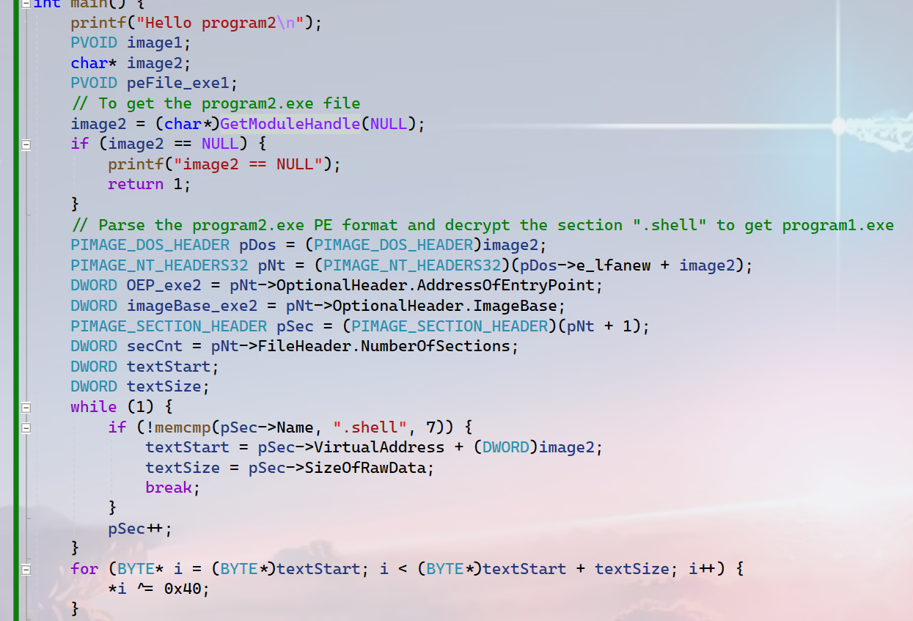
3 Project3
1.3 Code of program2.exe
Get the handle(address) of program2.exe in the memory by using API “GetModuleHandle”
And parse the program2.exe to get the program1.exe.
Certainly the program1.exe is stored in the last section named ”.shell” and encrypted. So we need to decrypt it for parsing.

Slide 34
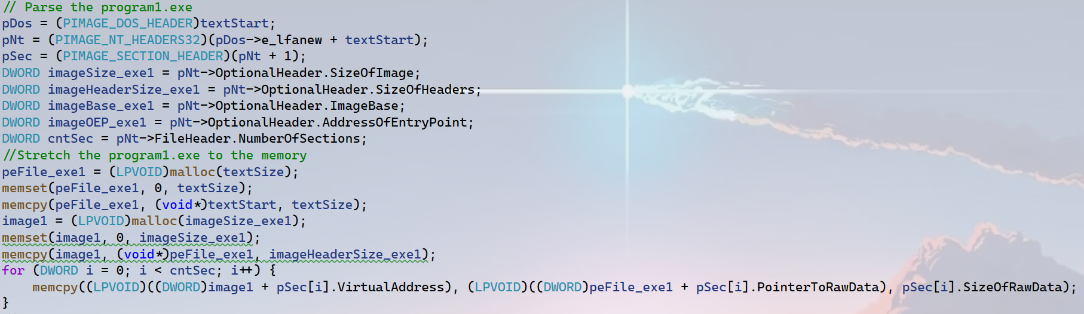
3 Project3
1.3 Code of program3.exe
Stretch the program1.exe into memory.
Notice: the operators are in the current process. And we need to imitate the OS to run the program1.exe.

Slide 35
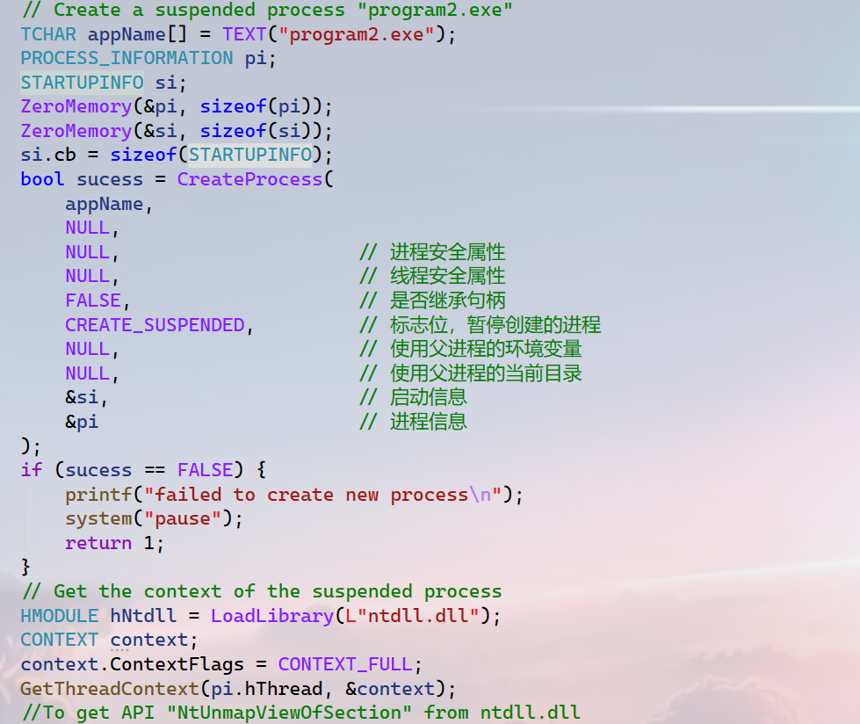
3 Project3
1.3 Code of program3.exe
Use the file “program2.exe” to create a new process and suspend it. Then the thread will not run.
Store the information of the main thread of the new process in the structure “CONTEXT”.

Slide 36
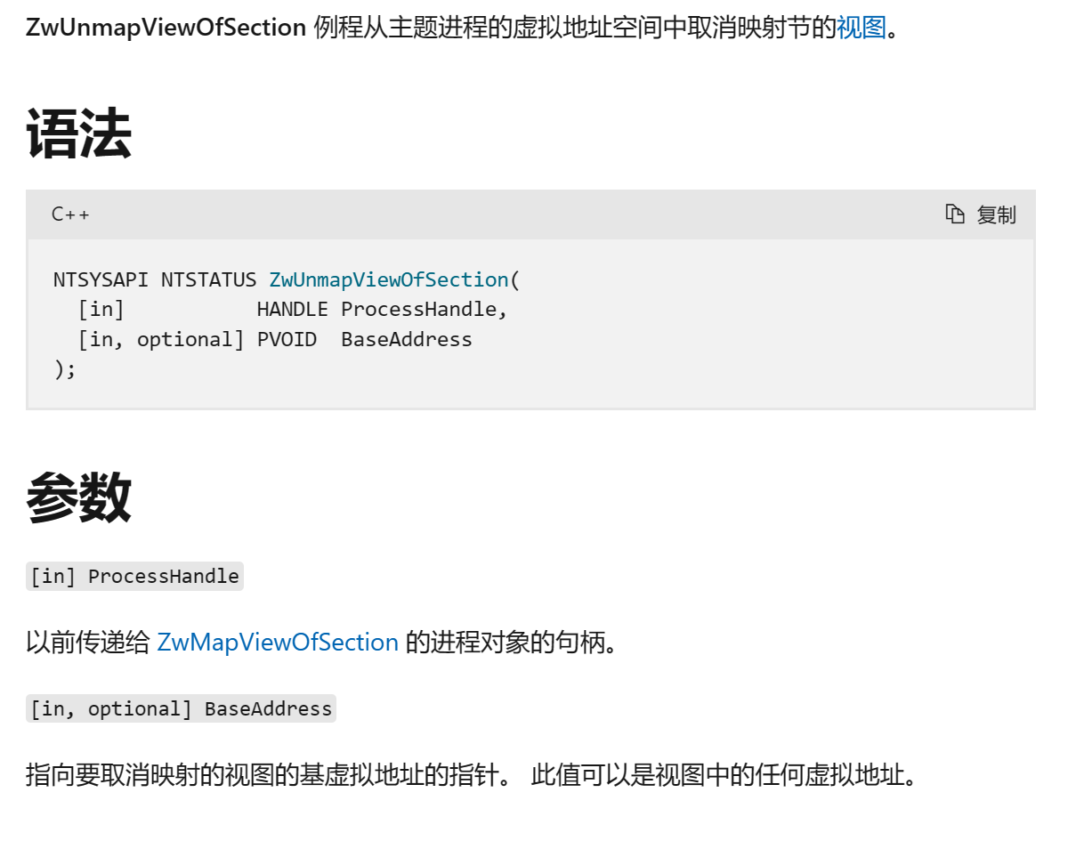
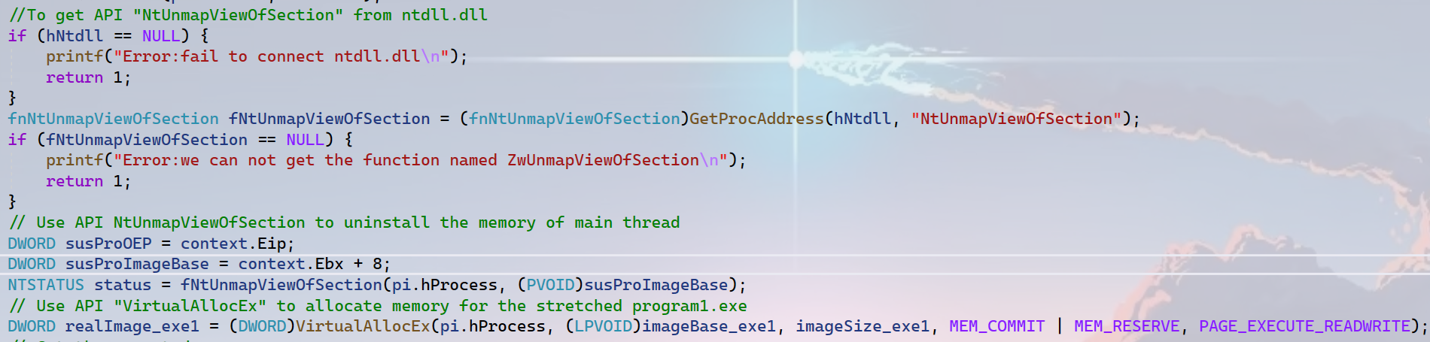
3 Project3
Uninstall the image of program2.exe in the suspended process.
1.3 Code of program3.exe

Slide 37
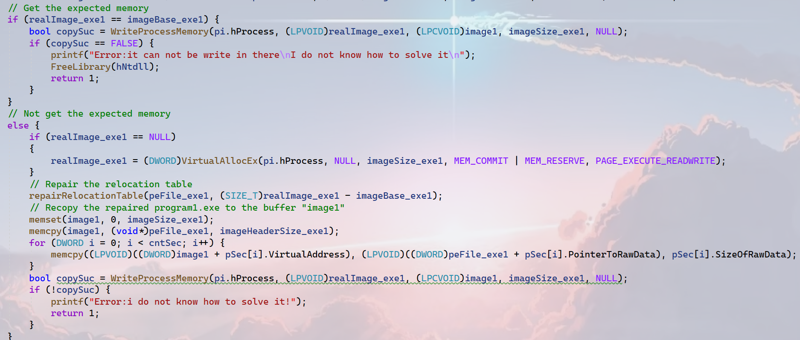
3 Project3
Write the stretched program1.exe into the memory of the suspended process. Then after I change the OEP of the main thread then the program1.exe can run.
1.3 Code of program3.exe

Slide 38
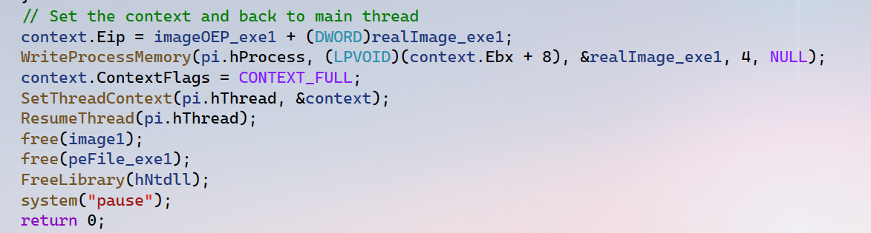
3 Project3
1.3 Code of program3.exe
1.I know that the Eip is the start address of the executed code in the thread. To run the program1.exe we need to set it. But I still do not know what the Ebx means! And why change it.
2.After set the context just resume the thread is OK.

Slide 39
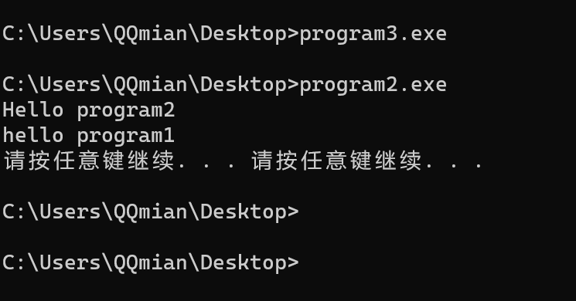
3 Project3
1.4 Result

Slide 40
1 Plan
plan 1
Finish the assignment1.
4

